Slide 1

ONLINE TEACHING AND LEARNING TOOLS
VIRAJ KOTHARI
FYIT
ROLL-NO:40

Slide 2
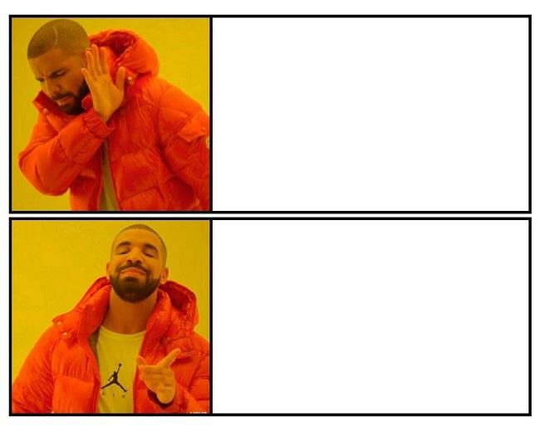
GOOGLE MEETING
MICROSOFT TEAMS

Slide 3
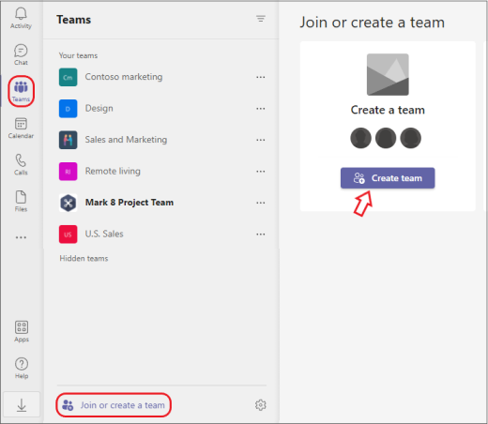
Creating Teams
Create teams by adding member individually by email aliases or security groups.
Every new team will have a default favorite ,channel called General you can use it whatever you like.
STEPS TO CREATE TEAM
Choose Teams on the left side of the app, then select Join or create a team at the bottom of your teams list.
Hover over the Create a team card and select Create team.
Decide what kind of team that you want this to be: To limit content and conversation to a specific set of people, choose Private.
For a community or topic that anyone in the org can join, choose Public.
Name your team and add an optional description.
When you're done, select Create.

Slide 4
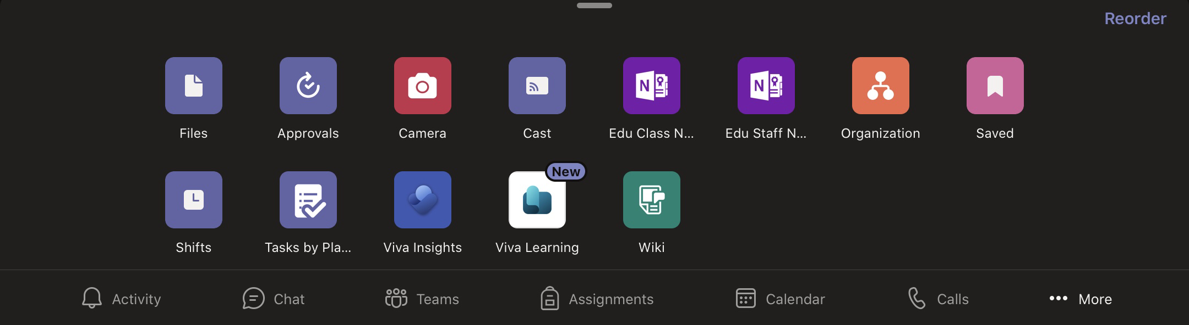
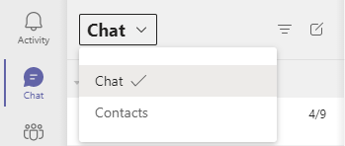
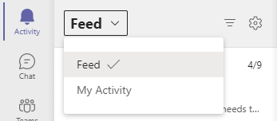
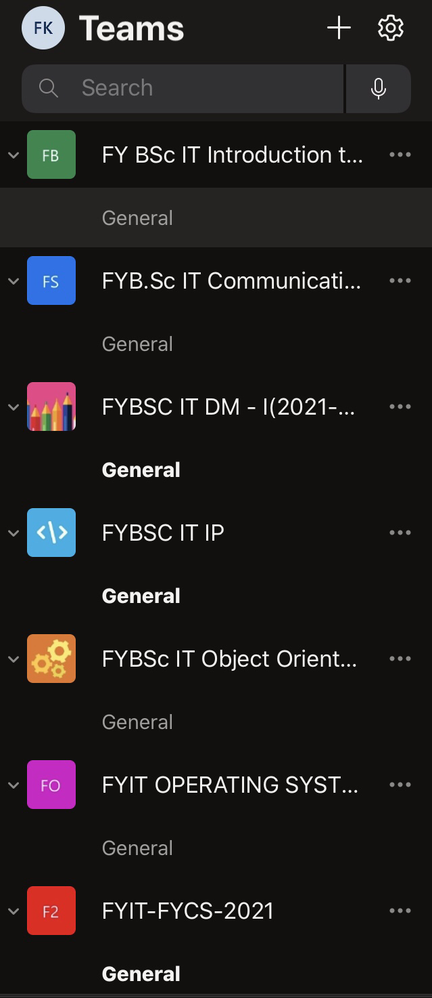
THE USE OF MS TEAM APPLICATION
Activity:A feed of all activity but you can toggle from Feed to My Activity.
Chat: A list of all your recent chats , which you can toggle to a list of Contacts.
Teams:A list of the Team groups you belong to.
Calendar:Your calendar, pulled in from Outlook.
Files:Recent files within the app and along with that it provides approval,Camera,Cast,Edu class notebook,Edu staff notebook and many more.

Slide 5

Advantages of Microsoft Teams
Advantages
An action / task orientated tool
An email substitute
Integrates Microsoft 365 features in the context of use
Works well with short form or visual content
It is Easy to set up
Switch between voice, text or video chatting in the interface
Integrate with Salesforce,Zendesk,Mailchimp and more

Slide 6

LIMITATIONS OF MICROSOFT TEAMS
Limited Storage.
Limited Number of Channels.
Limited Flexibility.
Transitional Challenge.
Storage space is limited to 2gb per user and a 10gb of shared storage.

Slide 7


